Slide 1
Executive Summary
Analysis also highlighted marital status of employees, noting approximately 49% as single, 34% married and 13% either separated, widowed or divorced. Additionally, some pay disparity was noted throughout the organization with male colleagues receiving on average 11% more pay than female counterparts. The analysis of pay vs race revealed on average white employees, both male and female received higher hourly rates throughout the company. Disparity among gender of different races were also highlighted.
To increase diversity within Fashion Producer XYZ, it is recommended that HR managers consider in future hiring to increase Hispanic and Native American representation in both genders from 3%, increase male presence by 5% throughout the organization, diversify administrative offices by decreasing from 60% females, by reviewing pay rates of females within the company and bringing American Indian/Native Alaska female pay on par with counterparts and also seeking to increase representation of eligible non US citizens.
In recent years, an increase in diversity and inclusion has been seen throughout the fashion industry. Having a diverse workforce enables a company to progress forward with fresh perspectives and increased productivity. Diversity in the working environment adds value and helps to improve innovation. It welcomes communication between internal stakeholders, encourages creativity to increase consumer spending, expand the market share and increase profit margins. Diversity in this report refers to age, gender, marital status, geographic location, professional/cultural experience and race. This report has been written to determine how diverse Fashion Producer XYZ is and to identify any pay disparity between gender and race with its active employees.
The findings of the diversity analysis conducted revealed that 62% of workers identify as White, 20% Black, 10% Asian and 8% as other under represented races. Similarly, the company workforce is made up of 55% female and 45% male. The information gathered identified no other known gender. The company’s labour force consists of 52% employees under the age of forty, 34% between ages 41-51 and less than 15% over the age of 52.

Slide 2
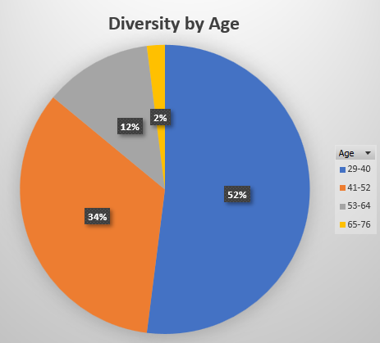
Results revealed a significantly younger workforce with over half of Fashion XYZ’s employees being between the ages of 29-40 and 34% between ages 41-52. Older employees are represented by a smaller percentage, possibly owing to retirement, etc.

Slide 3
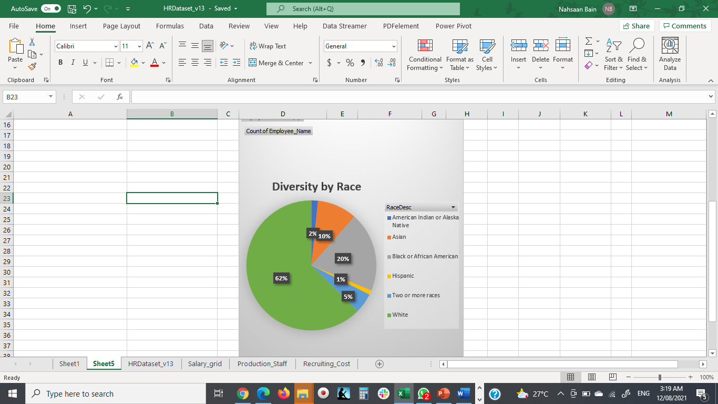
When analyzing diversity by race, results revealed a significantly high percentage of Caucasian workers (62%). Other races showed limited representation ranging from 20% black, 10% Asian, 5% and 2% representation of two or more races and American Indian/Alaskan Native Indians, respectively to 1% representation of Hispanic workers.

Slide 4
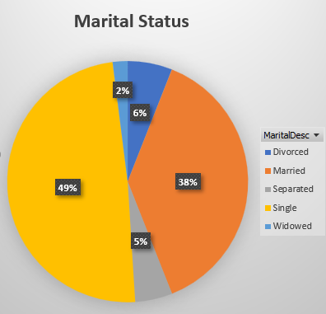
Fashion Producer XYZ diversity analysis indicates marital status of its employees, reporting 49% of its workers reporting as single, 34% married, 6% divorced, 2% widowed and 5% separated.

Slide 5
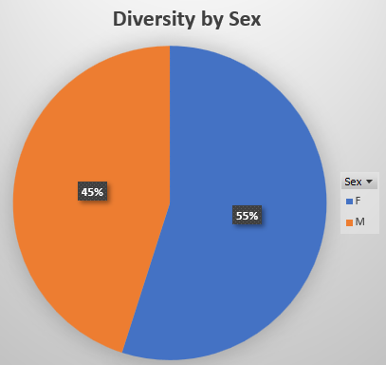
To determine how diverse Fashion Company XYZ is as it relates to gender/sex, an analysis was conducted to determine representation.
The results yielded an active workforce made up of 55% female and 45% male. There were no other identified genders.

Slide 6
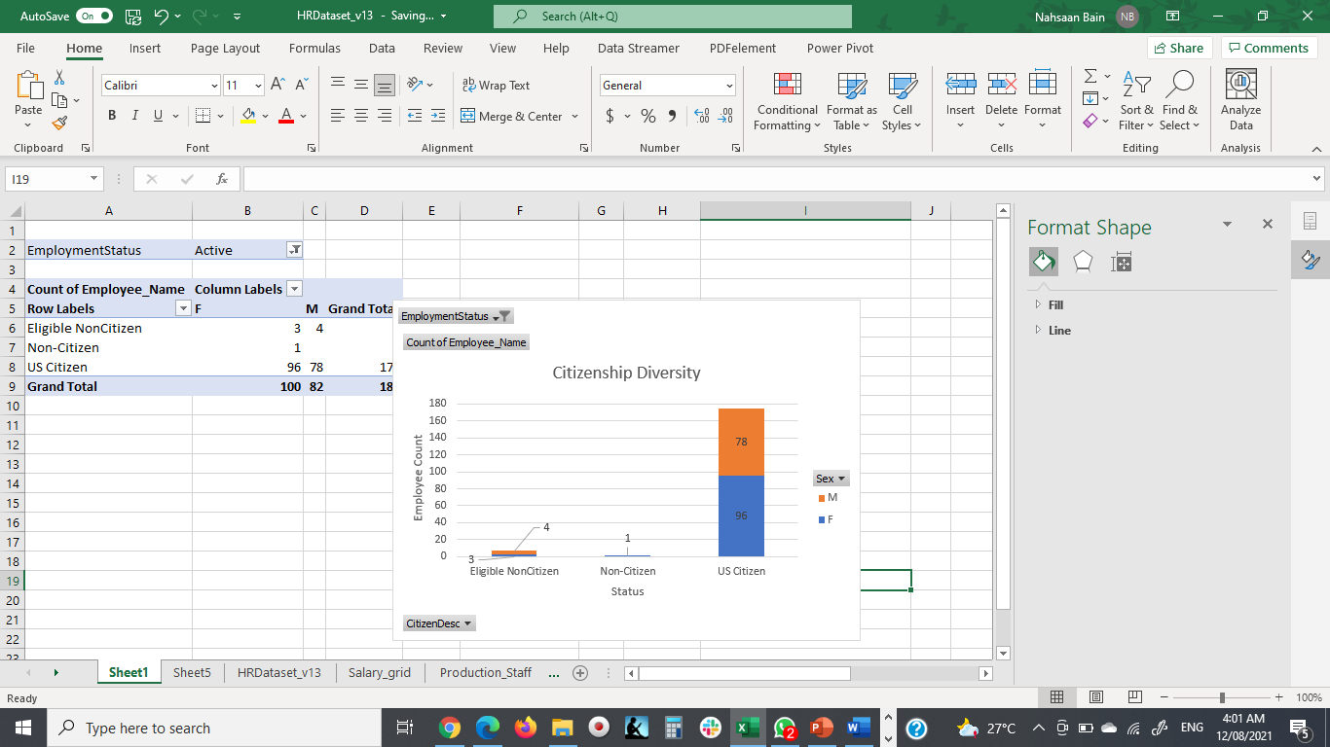
Analysis conducted determined Fashion Company XYZ’s workforce comprises primarily of US citizens. Seven eligible non-citizens are employed by the company while one employee holds a non US citizen status.

Slide 7
PAY DISPARITY AMONG GENDER
Disparity among gender of different races were also highlighted, noting Asian Data Analysts received approximately 28% higher pay rates than their counterparts of the same position. As did White male production managers received approximately 40%+ higher wages than black and white colleagues in the same position.

Slide 8
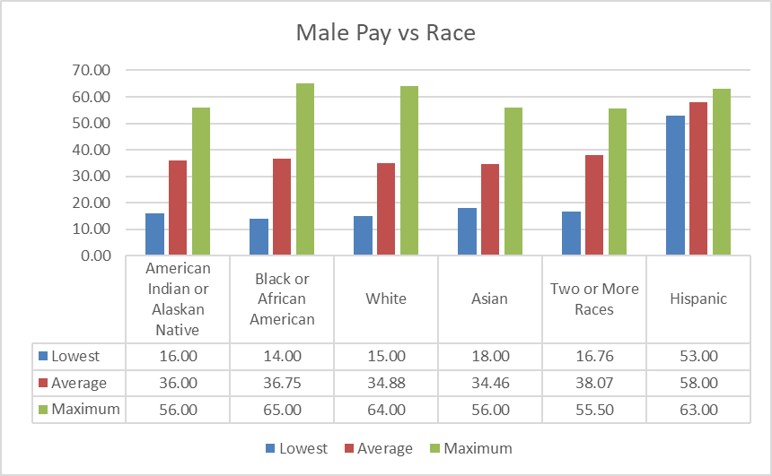
Pay disparity AMONG MALES
Analysis determined on average, both Asian and Caucasian men receive higher wages than their male counterparts. African American males receive 2% higher wages than male colleagues of other underrepresented races. Owing to underrepresentation of Hispanics, mixed races and American Indian/Alaska Natives, rates show higher in charts presented.

Slide 9
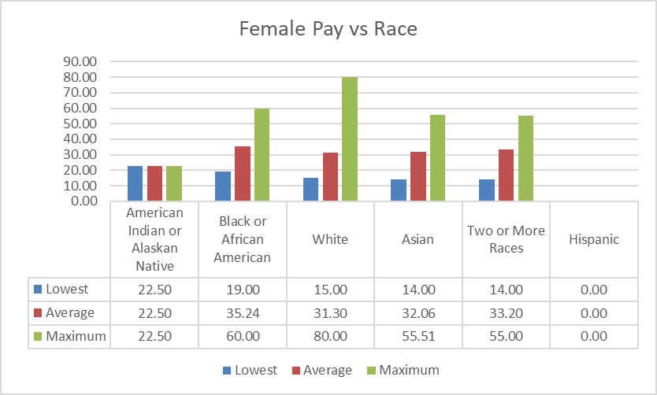
Pay disparity among females
On average, African American females receive 9% higher wages in the same department than female colleagues of other races. In managerial positions, Caucasian women are paid 33% more than other female managers. Owing to underrepresentation of Hispanics, mixed races and American Indian/Alaska Natives, rates show higher in charts presented.

Slide 10
While fashion producer XYZ shows some form of diversity, more can be done to increase representation of race, age, gender and disparity in pay rates among colleagues. To further diversify fashion producer XYZ, the following is recommended:
RECOMMENDATIONS AND CONCLUSION
Future hiring to increase Hispanic and American Indian/Native Alaska representation in both genders from 3% to 7% over the course of one fiscal year.
Increase male presence by 5% throughout the organization from 45% to 50%.
Expand employee workforce by 7% to include eligible non US citizen workers.
Diversify hiring to include workers who identify as other in gender.
Diversify administrative offices by including minority representation and male counterparts.
Increase female hourly rates to match male counterparts with same job position working in the same department.
Review pay rates of American Indian females to increase from 30% less than other female counterparts to being on par.

